Slide 1
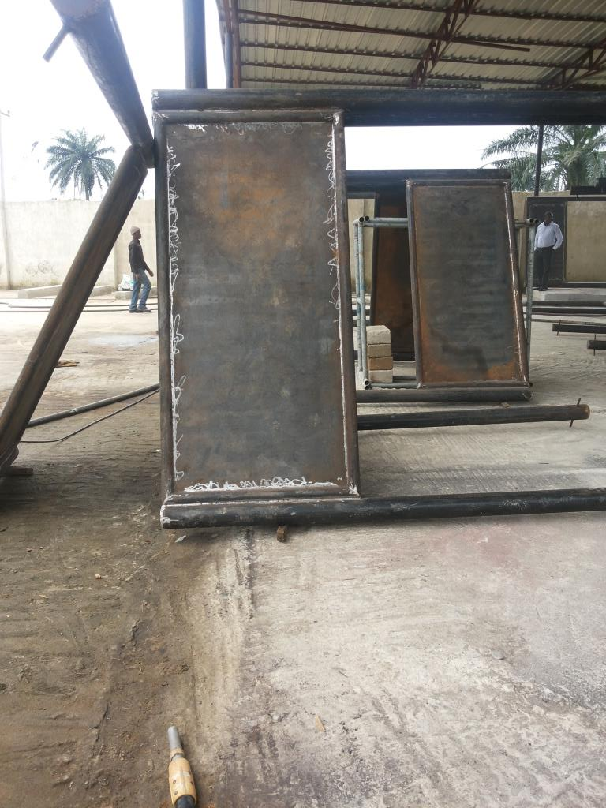
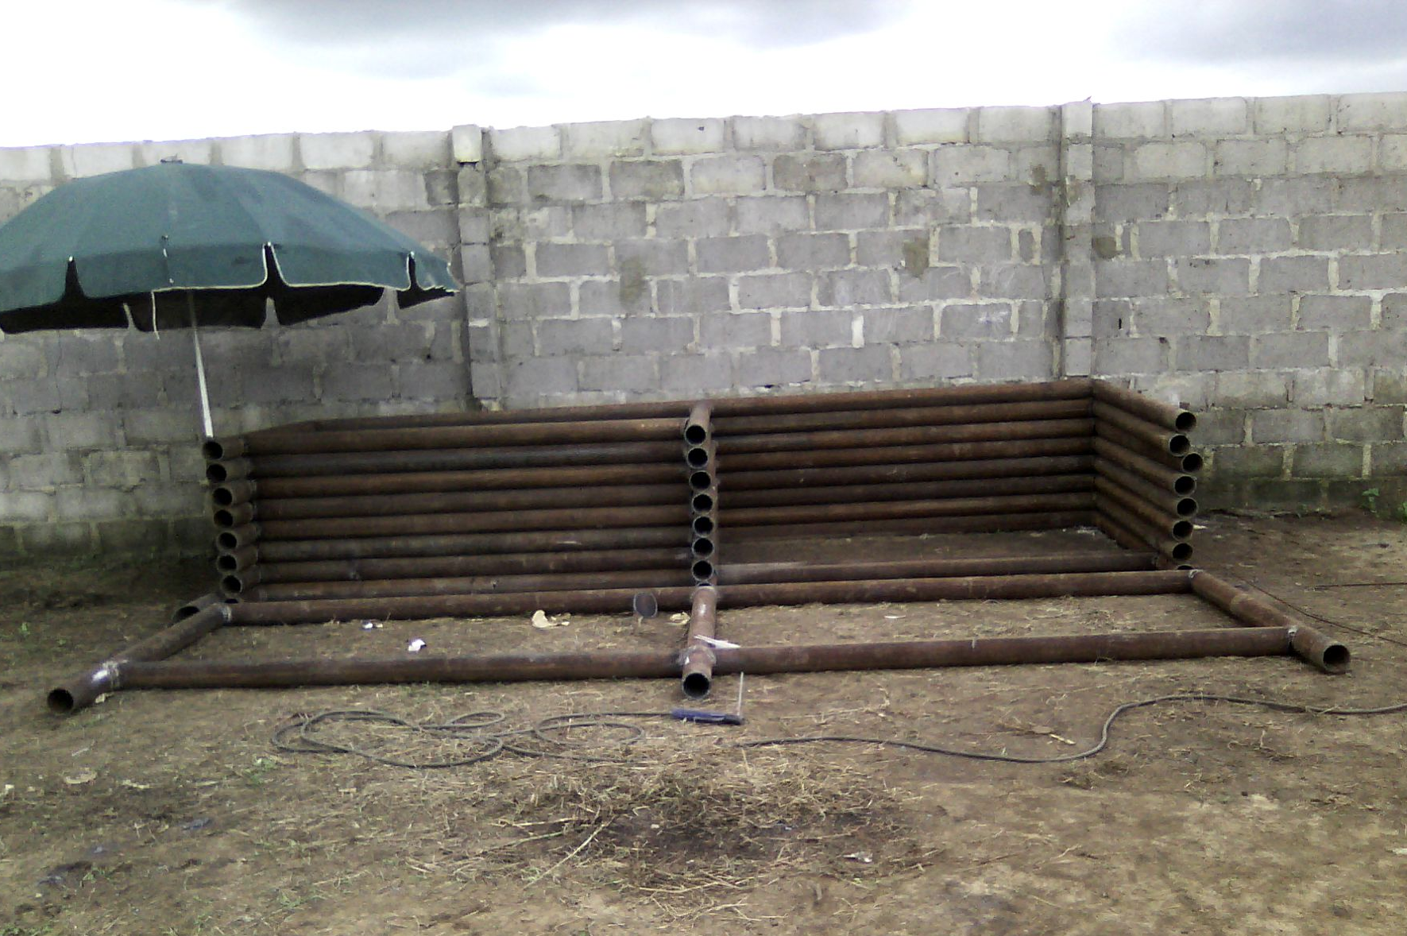
Fabricated Warning signs awaiting surface preparation, priming, painting and stencilling.
Fabricated movement breakers awaiting internal braces, surface preparation, priming and painting.

